Slide 1
Generating Point Clouds from Grasps Milestones
Christian Yankacar and Nikola Jankulovic

Slide 2
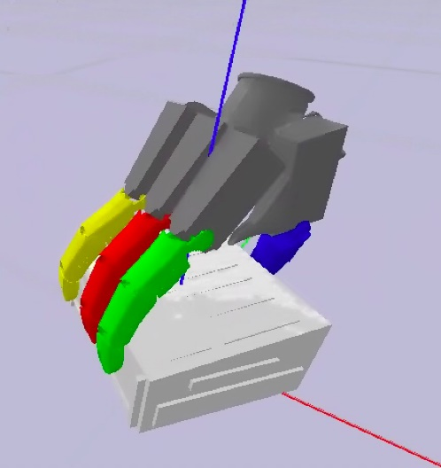
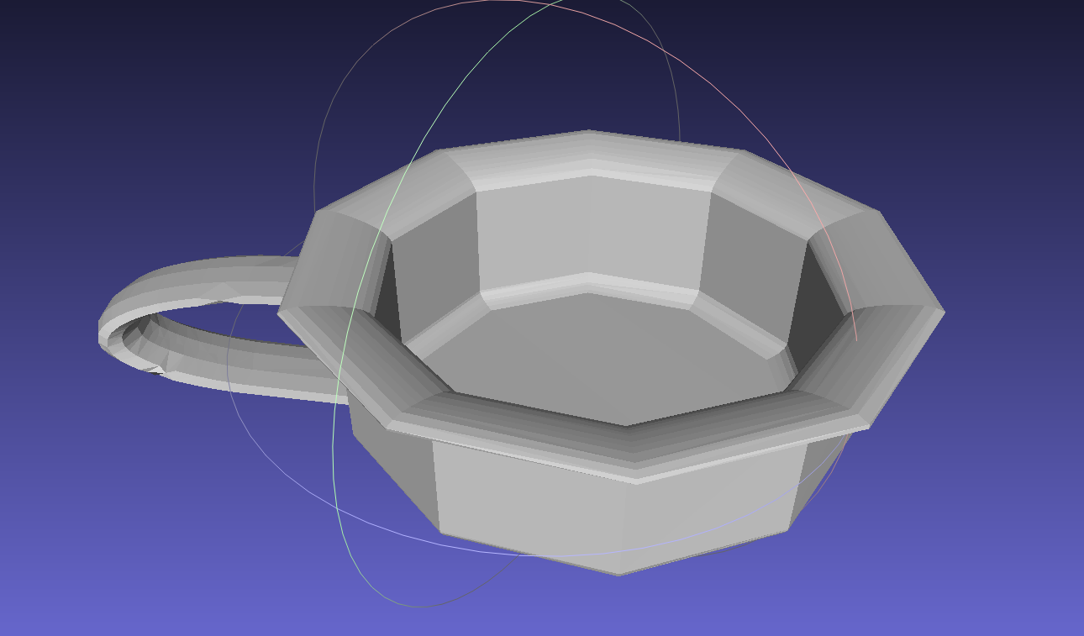
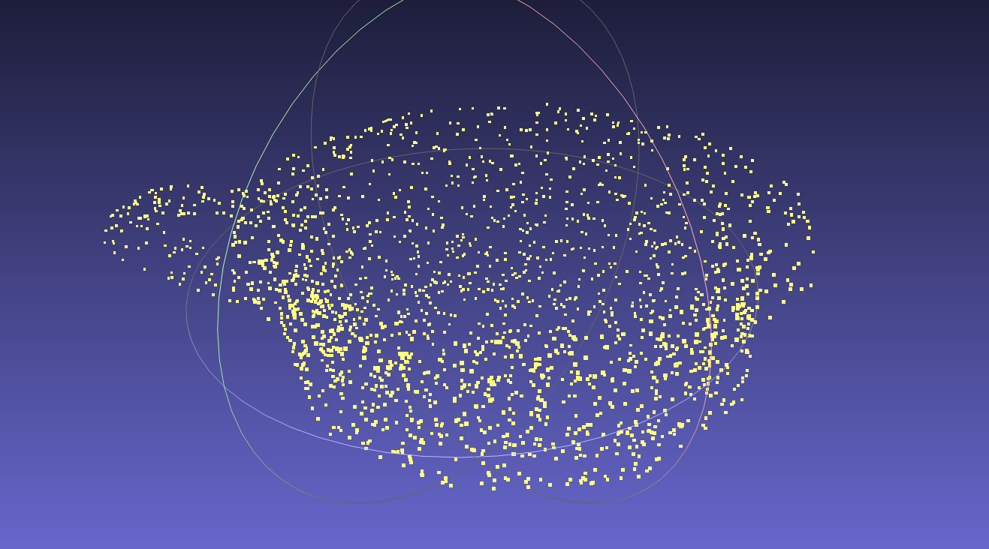




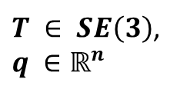
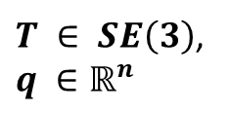
Problem Definition
Given Data
Training Data
$$+$$
Sample Point Cloud
$$+$$
Grasp
Object Mesh
Point Cloud
$${x∈ℝ}^{N×3}$$
Grasp
$T ∈ SE\left(3\right)$,
$$q ∈ℝ^{n}$$
$T ∈ SE\left(3\right)$,
$$q ∈ℝ^{n}$$
Deep Learning Pipeline
Diffusion Model
Postprocessing

Slide 3
Diffusion denoising model

Slide 4
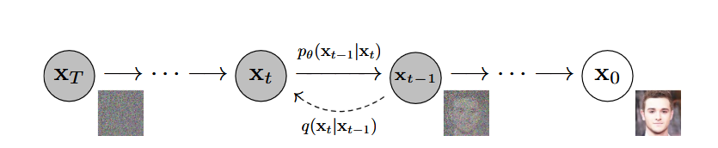
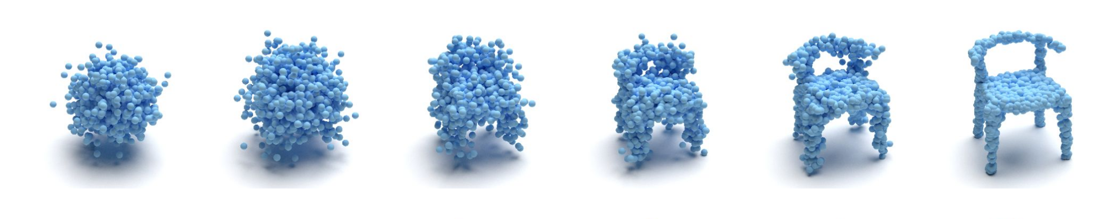
Diffusion denoising model
Diffusion process
Denoising process
DDPM
DDIM (30-60)

Slide 5
Architecture & hyperparameters
1x1
1x256
embedding
timestep
Nx3
Nx256
Nx(3*256)
Nx256
Nx3
ResBlock
point cloud
maxpool
1x256
Nx256
2x
Overfitted to 1, 2, and 3 objects
Data normalized, sample only once, no rotations
Timesteps: 1000
Epochs = 200, one epoch = 1000 timesteps
Loss: MSE, SNR, Chamfer, Mixed (all are very noisy)
Batch size: 32
Learning rate 0.0004. No scheduler

Slide 6
Results

Slide 7
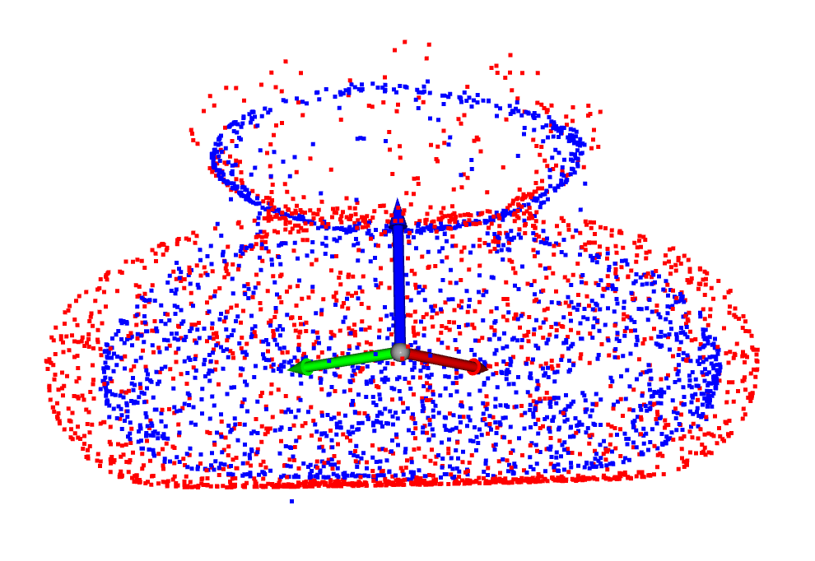
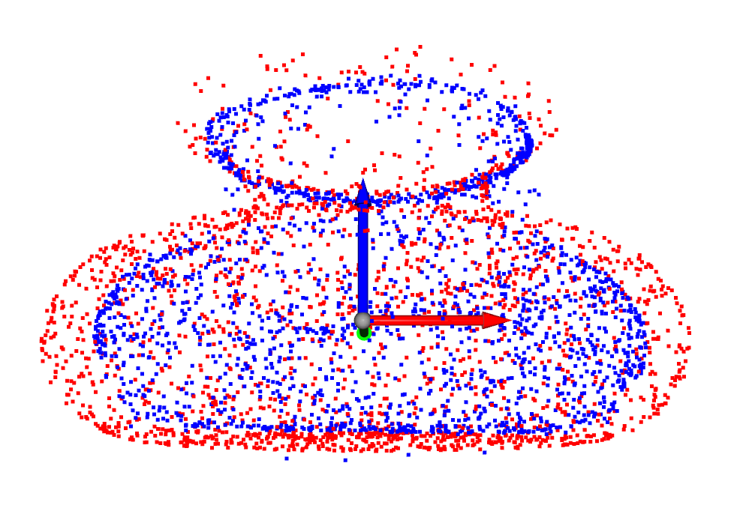
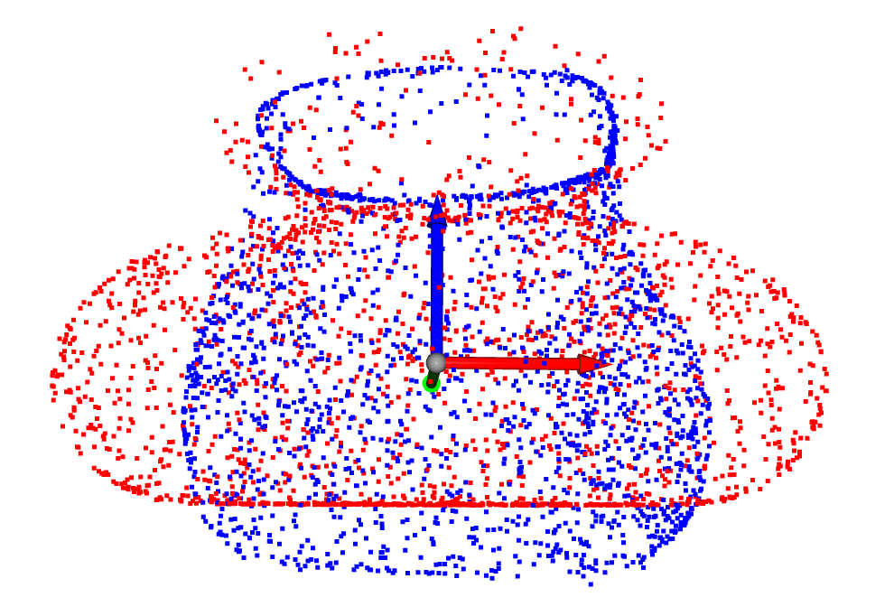
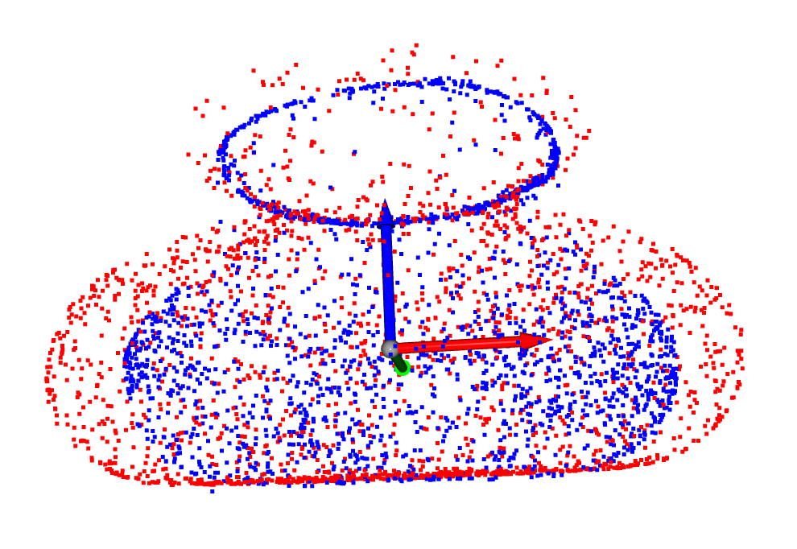
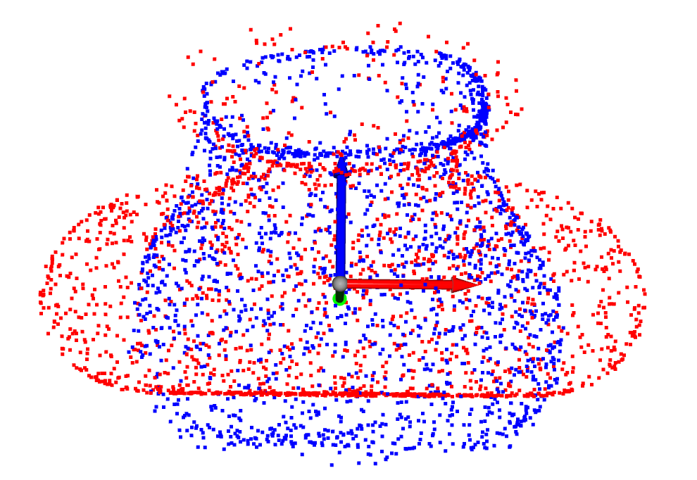
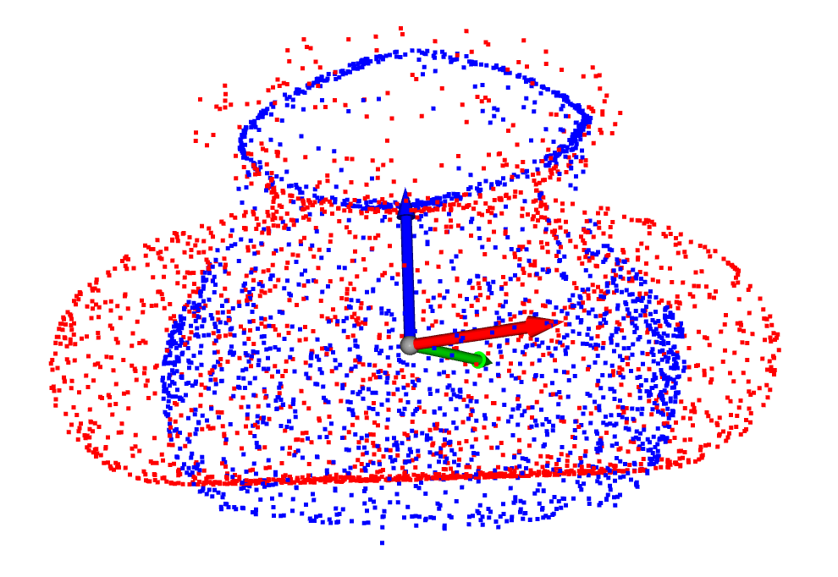
Two objects model results

Slide 8
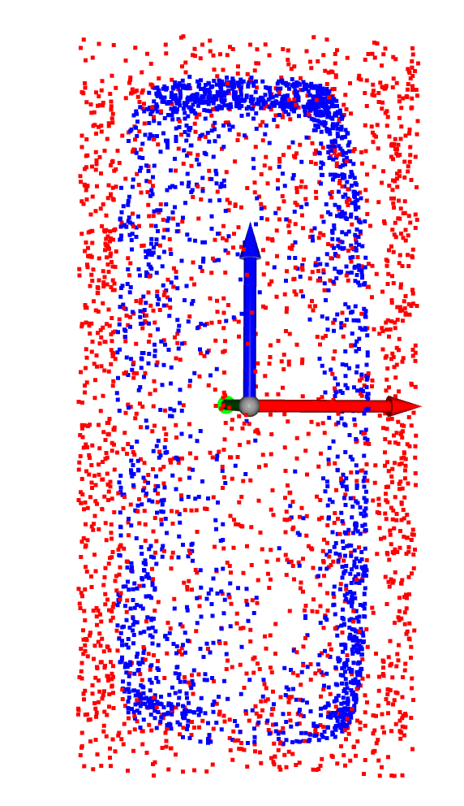
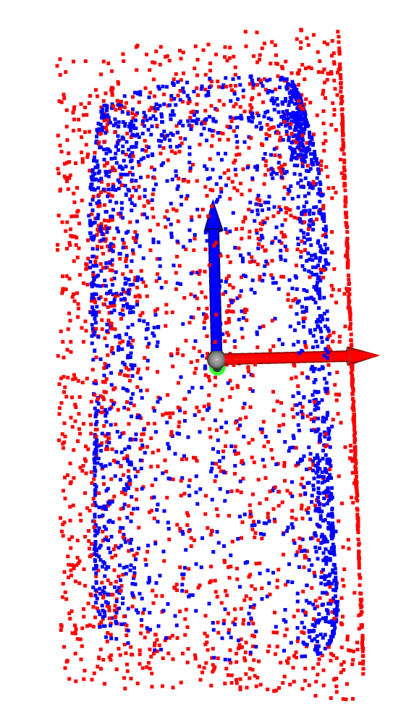
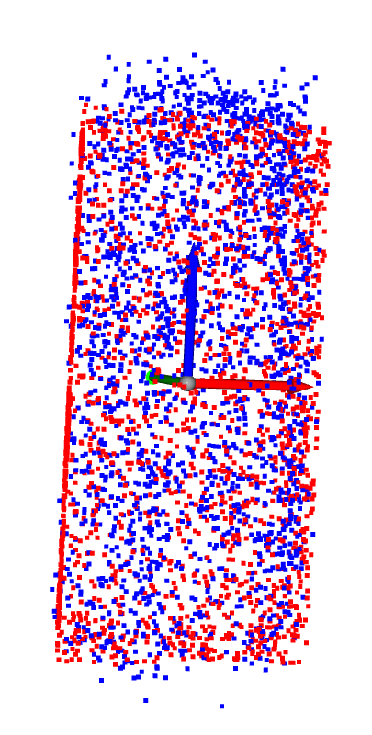
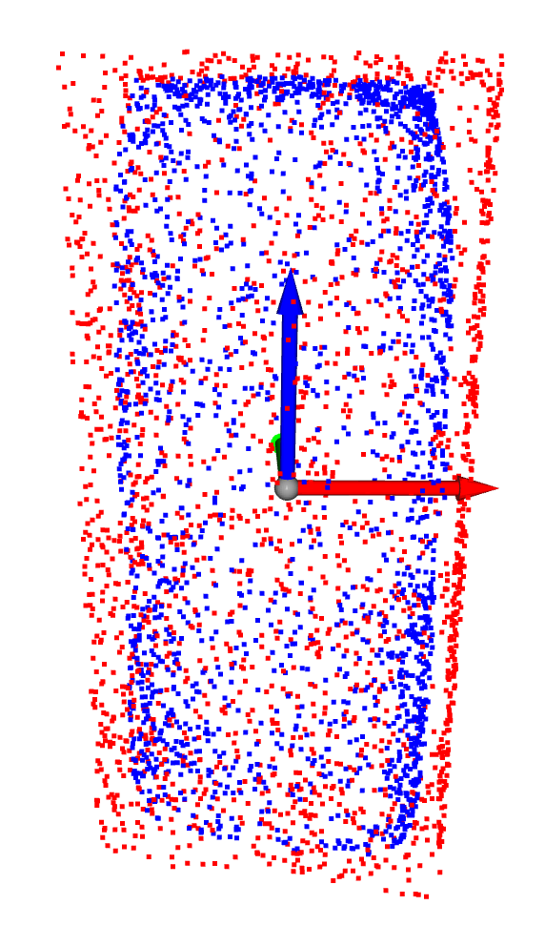
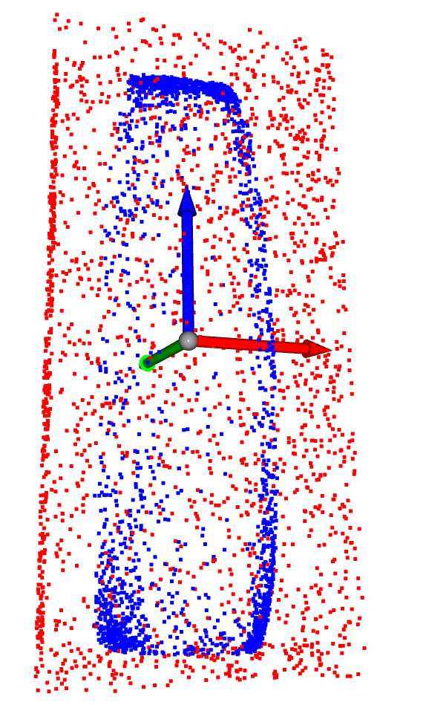
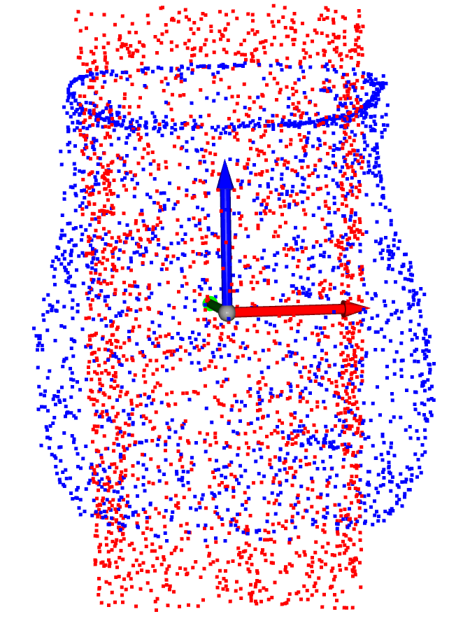
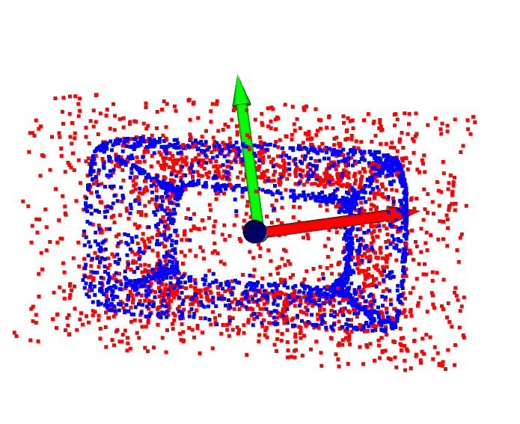
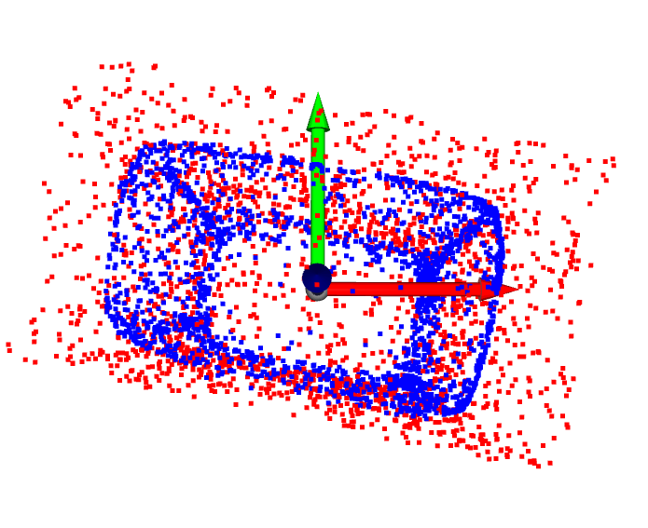

Slide 9
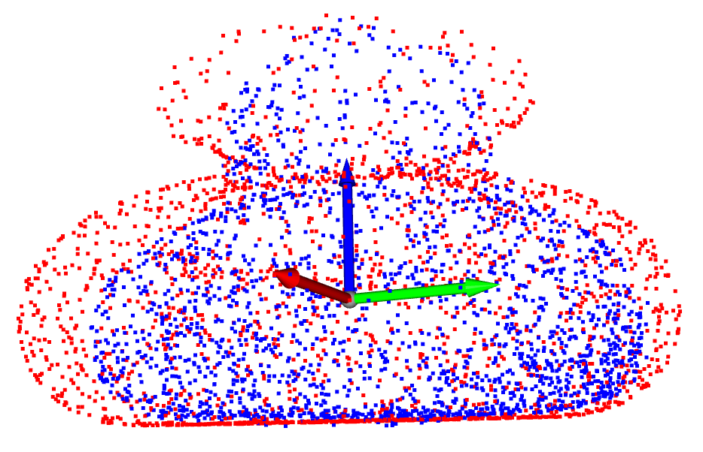
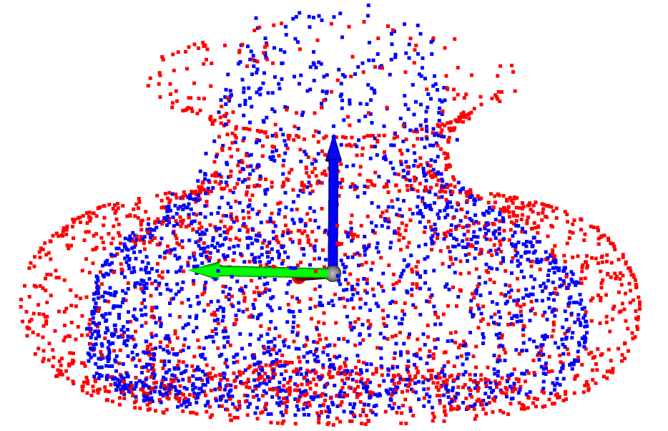
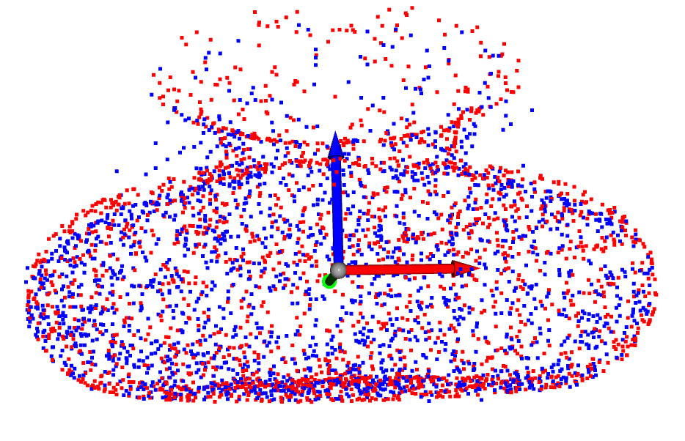
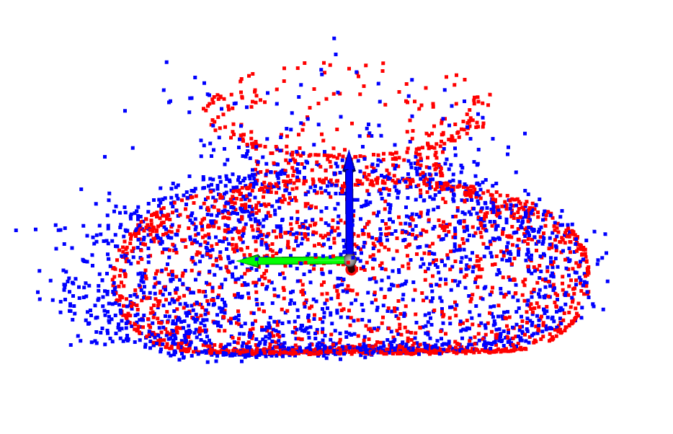
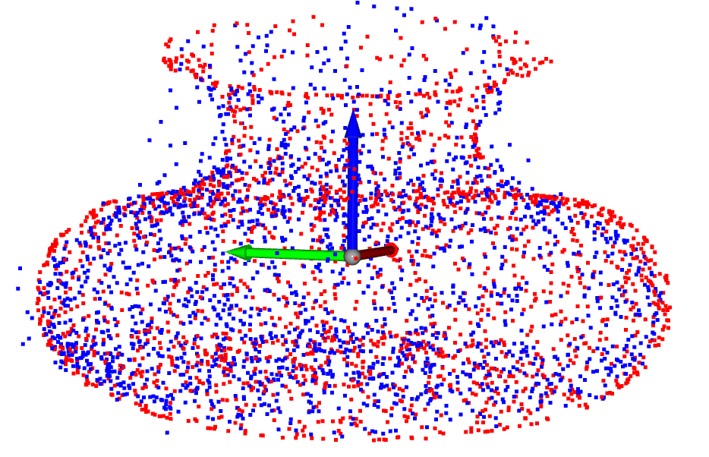
Three objects model result

Slide 10
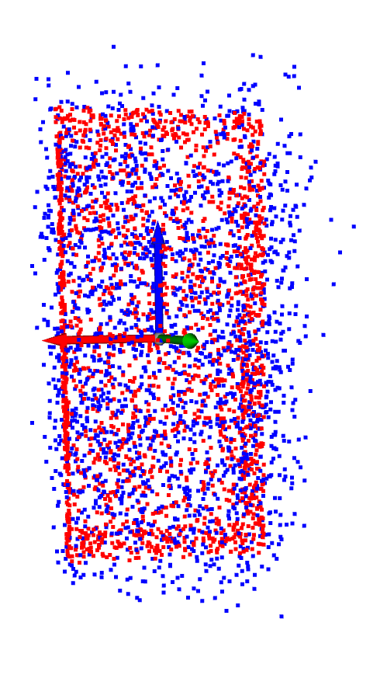
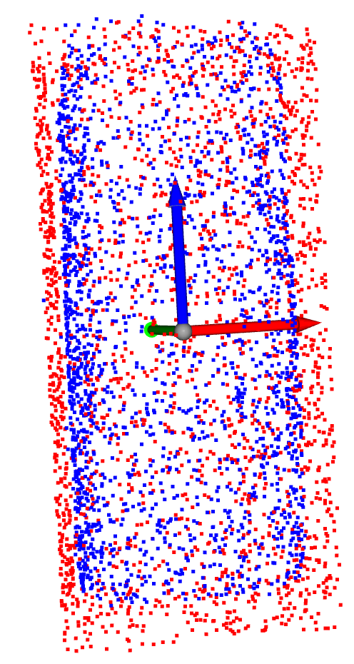
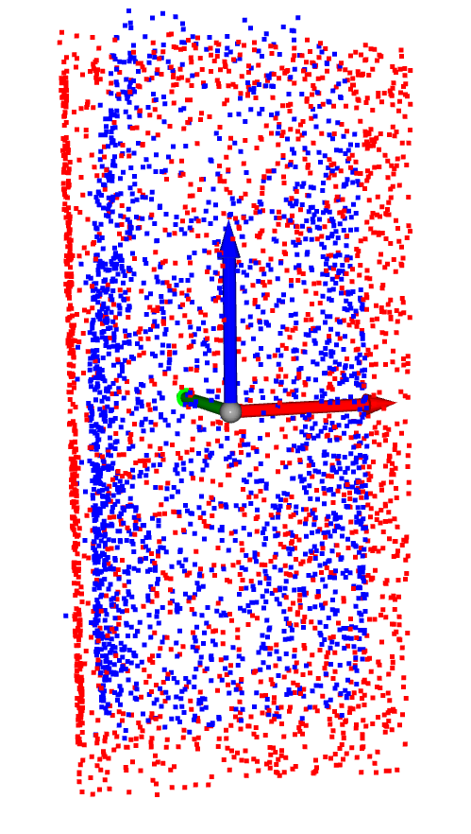

Slide 11
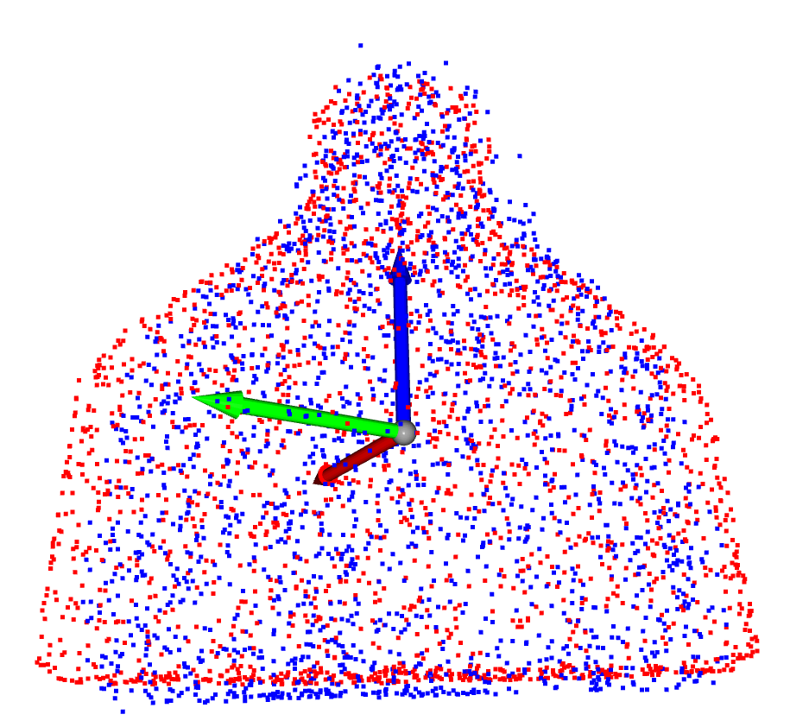
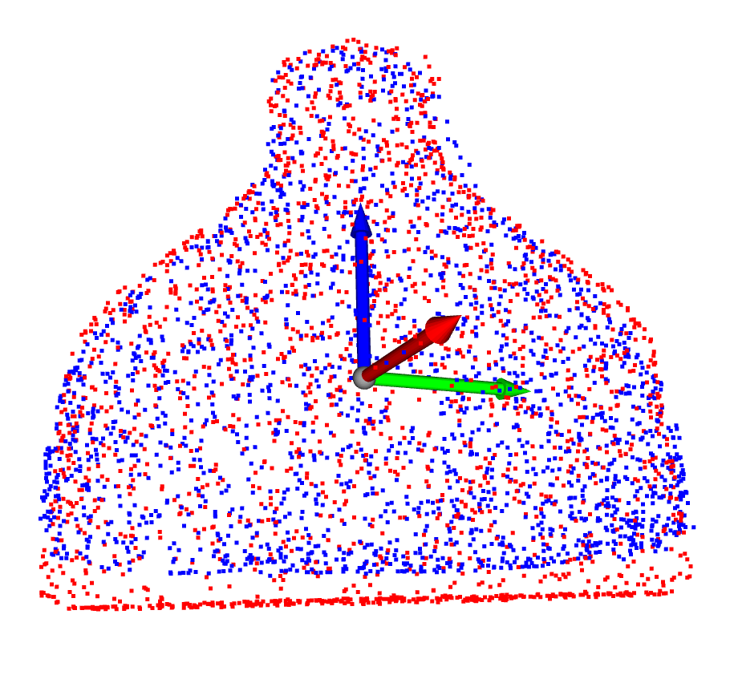
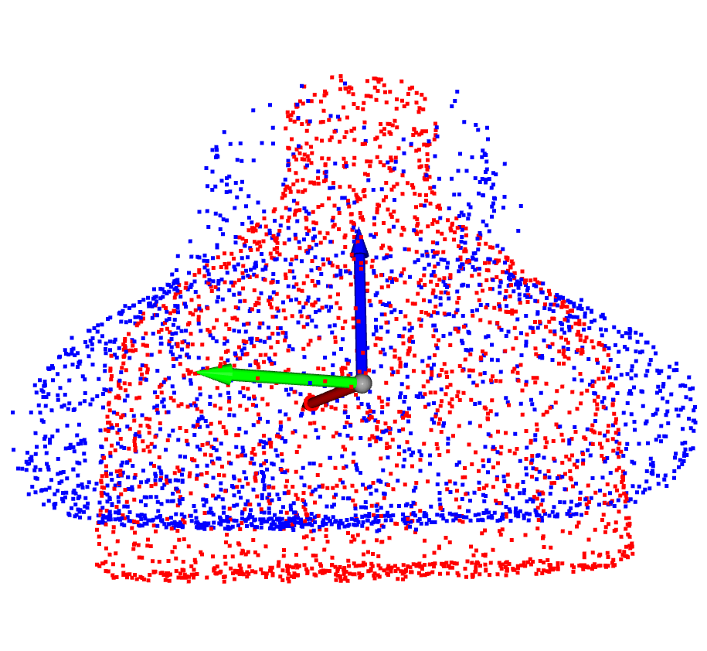
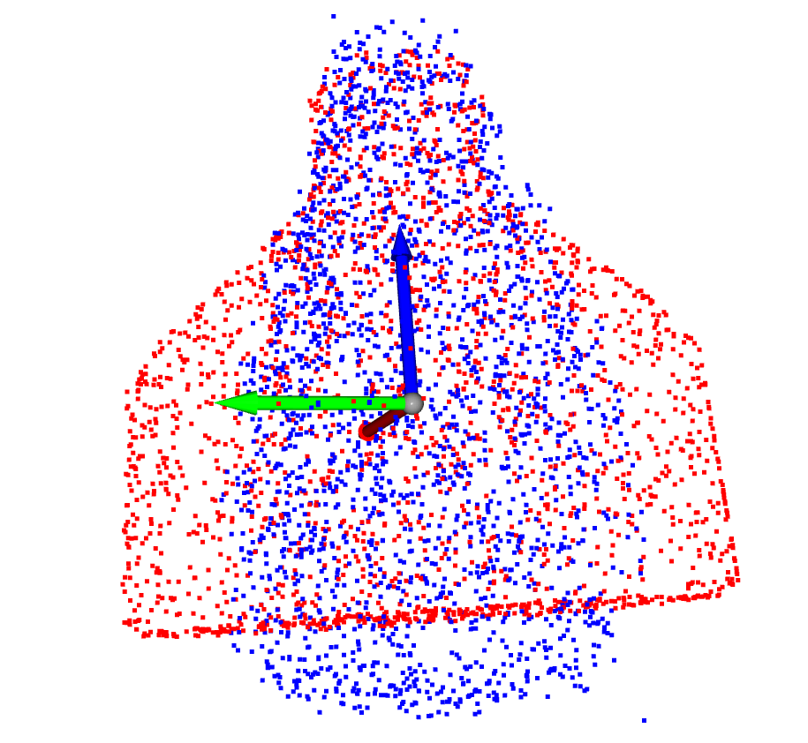
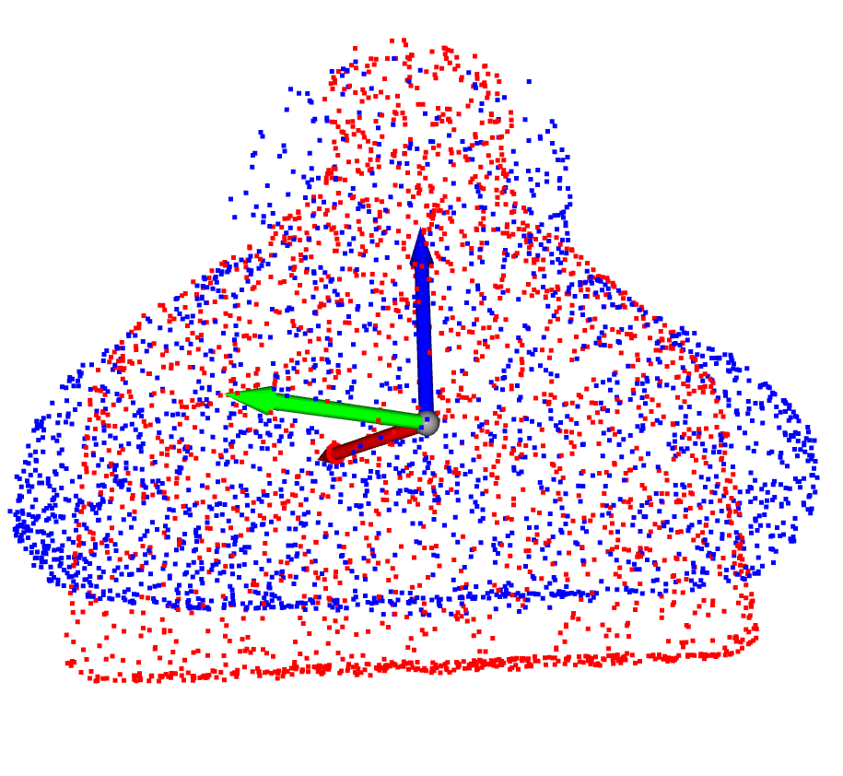

Slide 12
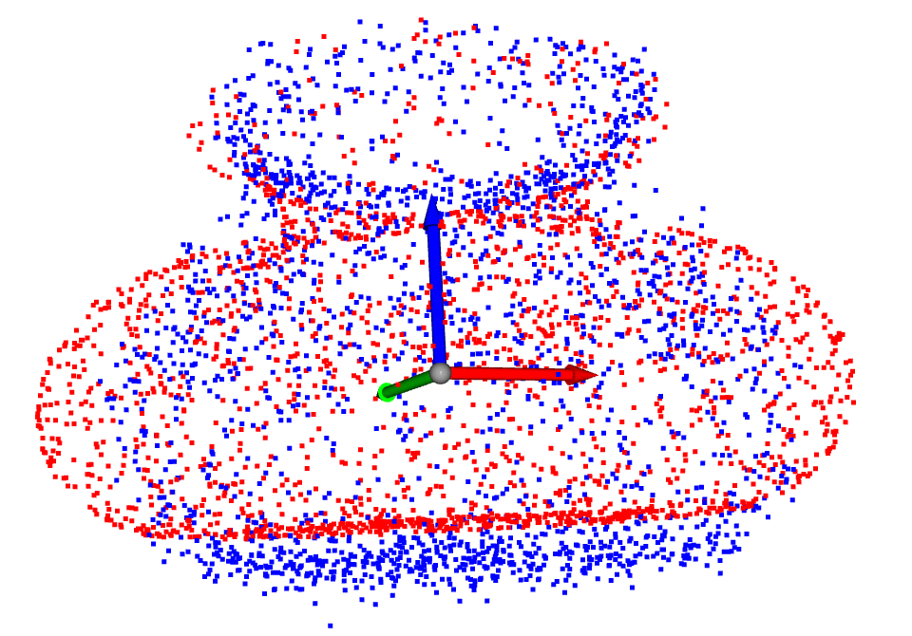
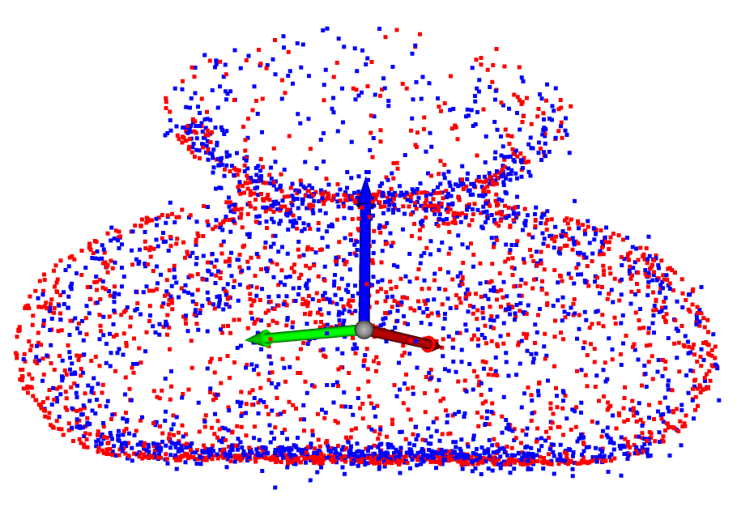
DDIM

Slide 13
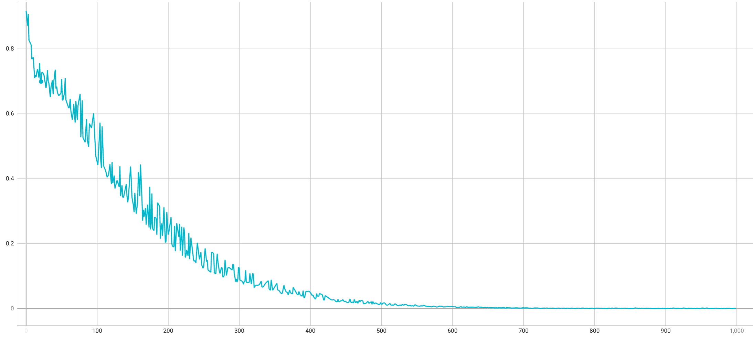
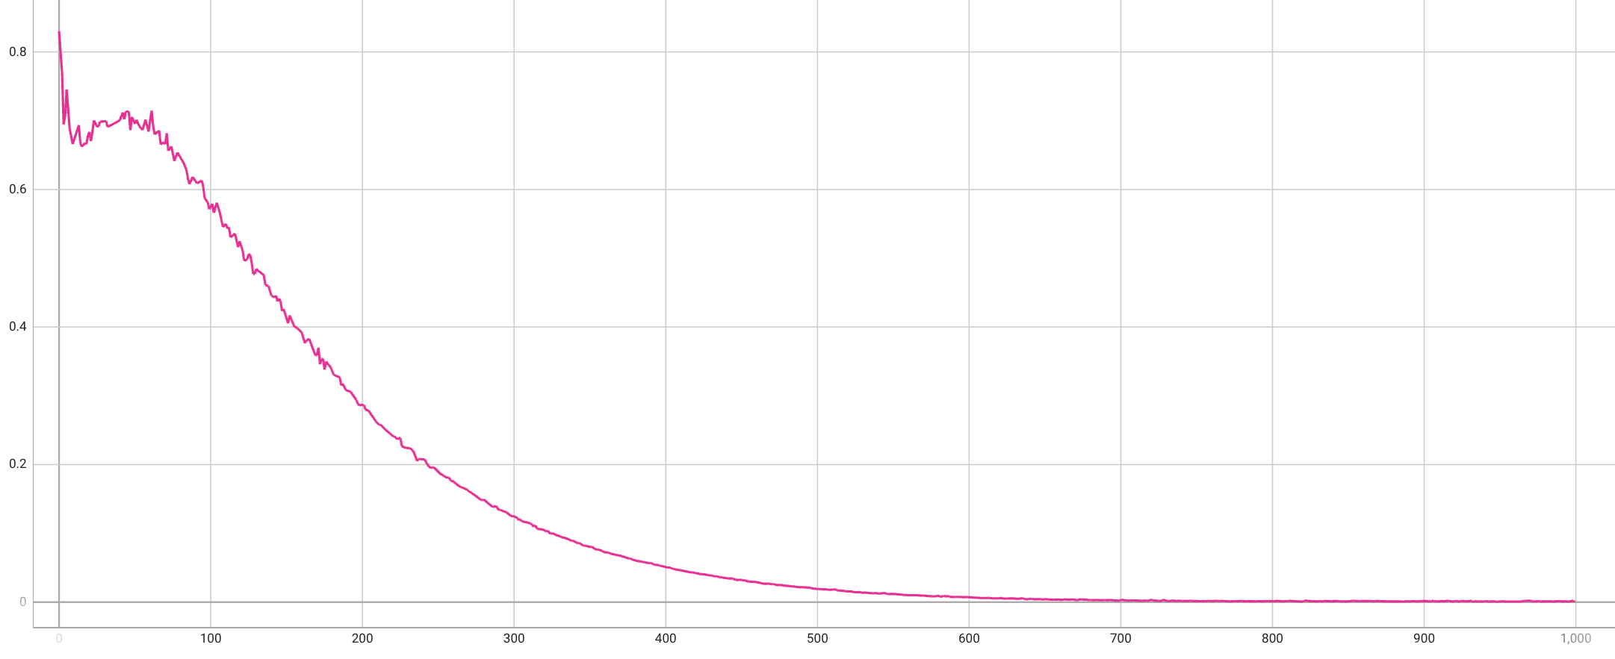
Average Timestep MSE loss
3 objects model
2 objects model

Slide 14










Diffusion-Autoencoder
Pointnet Encoder
Pointwise Decoder
$$μ$$
Reparame-trization
$$z$$
$$x_{0}$$
$$N\left(x_{t−1}|μ_{θ}\left(x_{t},z,t\right),β_{t}I \right)$$
$$σ^{2}$$
$$ℒ_{KL}\left\{q_{Φ}||N\left(0,I\right)\right\}$$
Model learns reverse Markov Chain
$$x_{t}$$
$$t\sim \left\{1, 2, 3, …,T\right\}$$
After T steps
$$x_{0}∈ℝ^{N×3}$$
Autoencoder
$$x_{t}=N\left(x_{t}| \sqrt{β_{t}−1}{ x}_{t−1},β_{t}I \right)$$
Can be defined as a forward Markov Chain

Slide 15
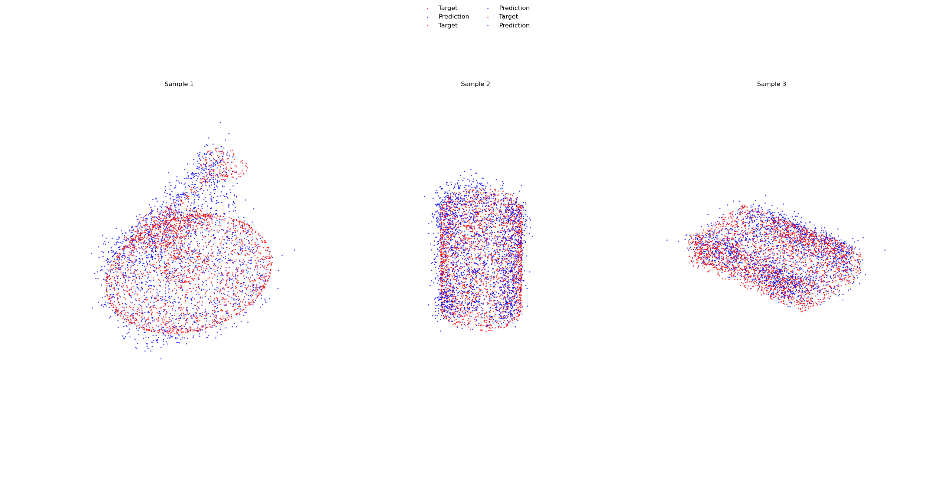
Autoencoder Predicted Point Clouds 2048 Points end-to-end
predicted
target
Sample 1
Sample 2
Sample 3
Chamfer Distance
0.0141
0.0116
0.0088

Slide 16
Autoencoder with Pretrained Encoder
predicted
target
Sample 1
Sample 2
Sample 3
Chamfer
Distance
0.0056
0.0039
0.0050

Slide 17







VAE Architecture
Self-supervised training
Pointnet
Encoder
Resnet
decoder
$$μ$$
Reparametrization
$$x$$
$$z$$
$$\hat{x}$$
$$σ^{2}$$
$$ℒ_{KL}\left\{q_{Φ}||N\left(0,I\right)\right\}$$
$$ℒ_{CD}\left\{x,\hat{x}\right\}$$
Conditioning Loss on Latent Space
Chamfer for Reconstruction works better than MSE on Point Clouds
$$ℒ_{Total}={ℒ_{CD}\left\{x,\hat{x}\right\}+β_{KL}ℒ}_{KL}\left\{q_{Φ}||N\left(0,I\right)\right\}$$
$β_{KL}$: KL-Annealing increases linearly during training until a predefined upper bound

Slide 18
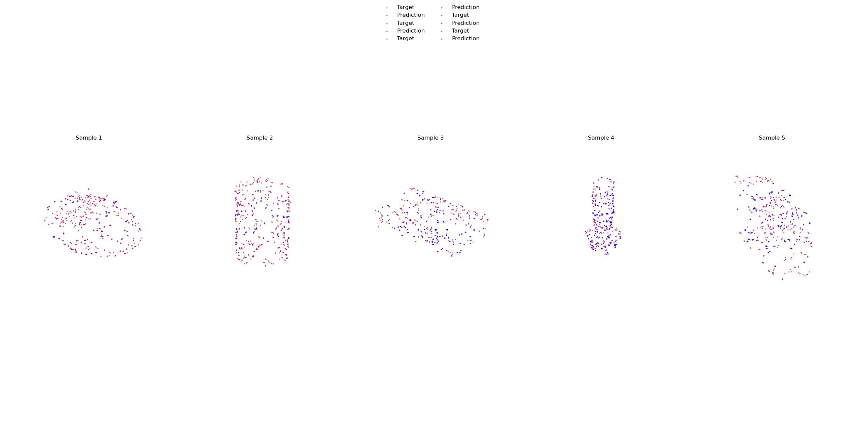
Comparing predicted vs target PCs
predicted
target
Sample 1
Sample 2
Sample 3
Sample 4
Sample 5
Chamfer
Distance
0.0019
0.0016
0.0015
0.0007
0.0013
Best reconstructions yet, but VAEs known for bad scaling properties to large data sets
Not as flexible as Diffusion-Autoencoder, number of points fixed

Slide 19


Outlook
Native Diffusion conditioned on Grasps
Test the limits of the VAE
How many shapes can the VAE learn
How accurate are the reconstructions when trained on more shapes
Grasp conditioned Diffusion-Autoencoder
Diffusion
Diffusion
$$z$$
Diffusion

